Slide 1
Next Generation Blockchains
Loi Luu
National University of Singapore
September 2016
Microsoft Research Asia PhD Fellowship Program

Slide 2

Background
3rd year PhD student
School of Computing, NUS
Advisor: Dr. Prateek Saxena
President Graduate Fellowship
Czar for Bitcoin Research Club at NUS
Before PhD
Bachelor of Computer Science
Vietnam National University, Hanoi
First class honor, salutatorian

Slide 3
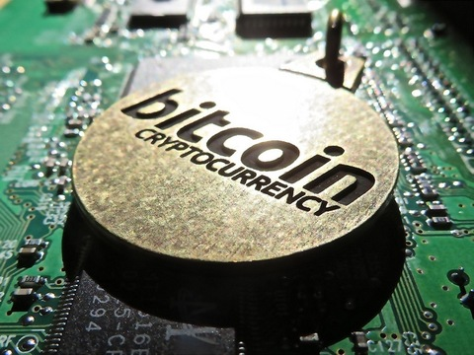

Research Interest
Topic of interests
Cryptocurrencies, blockchains, consensus protocols in distributed system
Applied cryptography & Programming languages
Goals
Design secure, scalable and efficient blockchain protocols

Slide 4
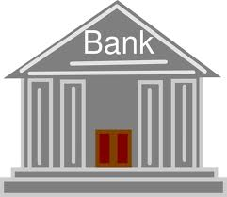
Blockchain: Distributing Trust & Enforcing Neutrality
Centralized Operator
Decentralized Operators
P1
P1
Problems:
Single point of Failure
Mutability / Forgery of Records
Properties
Verifiability
Immutability
Resilience
P6
P2
P6
P2
P5
P3
P5
P3
P4
P4

Slide 5
Blockchains: A Paranoid Level of Distribution in Trust
Classical Distributed Systems
Blockchain Protocols
Paxos, PBFT
Secure Multiparty Computation
Nakamoto Consensus (Bitcoin)
Examples
10-20 nodes
Quadratic comm. complexity
10, 000 nodes
Linear comm. complexity
Size
Assumptions
Known identities
Shared timestamp
Trusted PKI
Incentive-less
No trusted PKI
Use PoW/ PoS
Good incentives

Slide 6
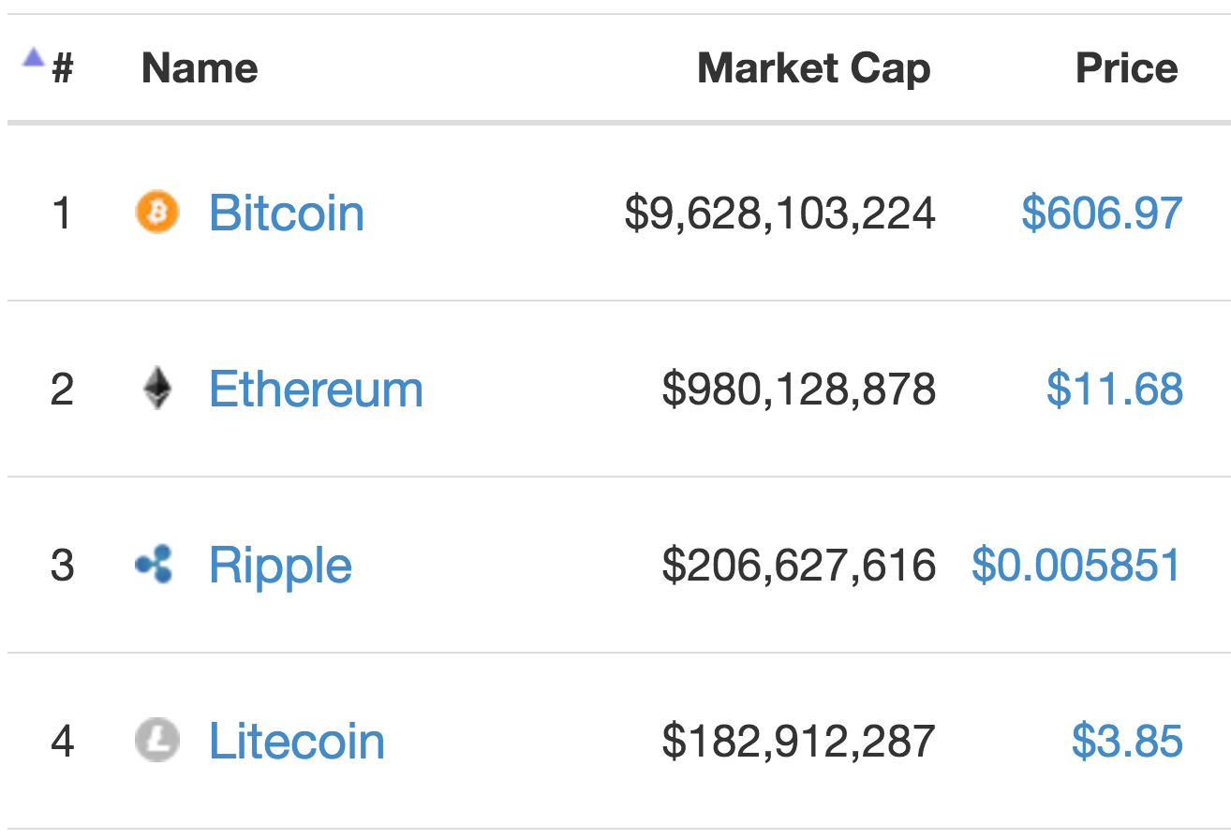
Why blockchains?
It has had impact on the world
It has fascinating research problems
Network: How can we share transactions & history?
Application: How can we agree on how to interpret the history?
Consensus: How can we agree on one global history?
Identity: How to determine who are network operators?

Slide 7




Research Thesis
Towards next-generation blockchains
Security
Scalability
Data Privacy
Applications
Provide better security guarantee
Handles large
number of nodes
& transactions
Provide Better Data and Transaction privacy
Support more applications

Slide 8



Research Directions
Current blockchains
Next generation blockchains
RD1. Analyze and improve
RD2. Design
new protocols
RD3.Devise new use-cases

Slide 9
Previous Projects

Slide 10

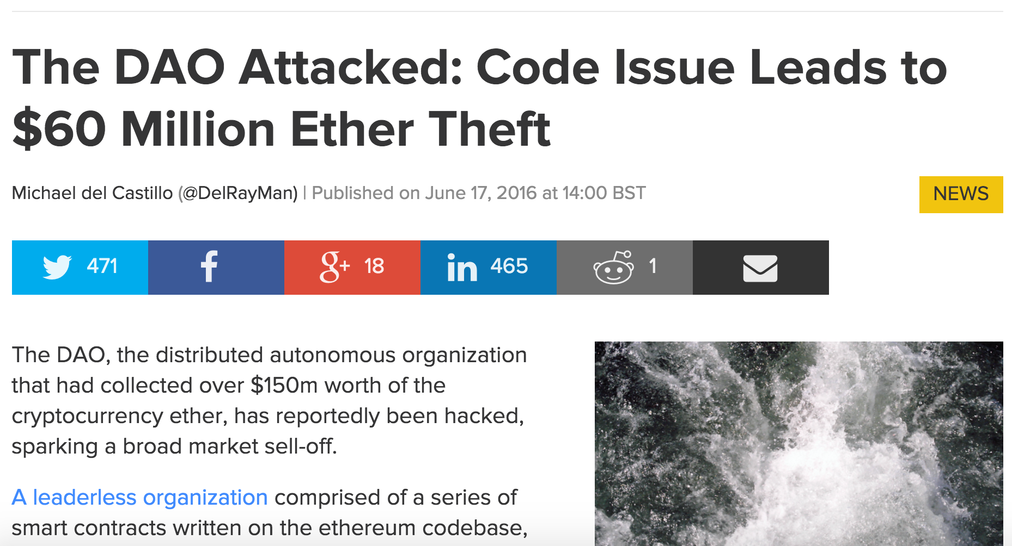
RD1. Making Smart Contracts Smarter [CCS ’16]
Smart contracts
Programs on blockchain
but != normal programs
Self-executed
Cannot patch
Our contributions:
Identify new class of flaws
Transaction Ordering Dependence
Timestamp Dependence
Exception Mishandling

Slide 11
RD1. Making Smart Contracts…(2)
Our contributions:
Propose several solutions
Implement and release a tool
Use symbolic execution
Flag 8,836 real-world smart contracts as buggy
The tool is available for public use
Featured on the news: CoinDesk
Integration underway with Ethereum Foundation
https://github.com/ethereum/oyente

Slide 12
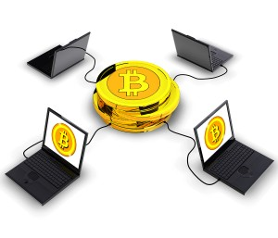

RD1. Study Existing Blockchains
My Other Works
Verifiers’ dilemma (CCS ’15)
Introduce attacks to nodes (verifiers)
Influence the future design of Ethereum
Block Withholding Attack (CSF ’15)
Game theoretic analysis
Pooled mining is vulnerable
Notes:
Both the attacks have been carried out in practice

Slide 13
RD2. A Secure Sharding Protocol For Open Blockchains [CCS ‘16]
Existing blockchain protocols are not scalable

Slide 14
RD2. A Secure Sharding Protocol For Open Blockchains [CCS ‘16]
Existing blockchain protocols are not scalable
High
2 Turing Awards
BFT
Protocols
?
$12 Billion market
Bitcoin /
Blockchain
Low
Small
Large

Slide 15

RD2. Elastico: Linear Scalability
High
Elastico
Protocol
BFT
Protocols
Bitcoin /
Blockchain
Low
Small
Large
Notes:
We introduce Elastico, the first candidate for such protocols which allows the transaction rate to increase linearly with the network size. That means, you add more nodes to the network, you can process more transactions.

Slide 16
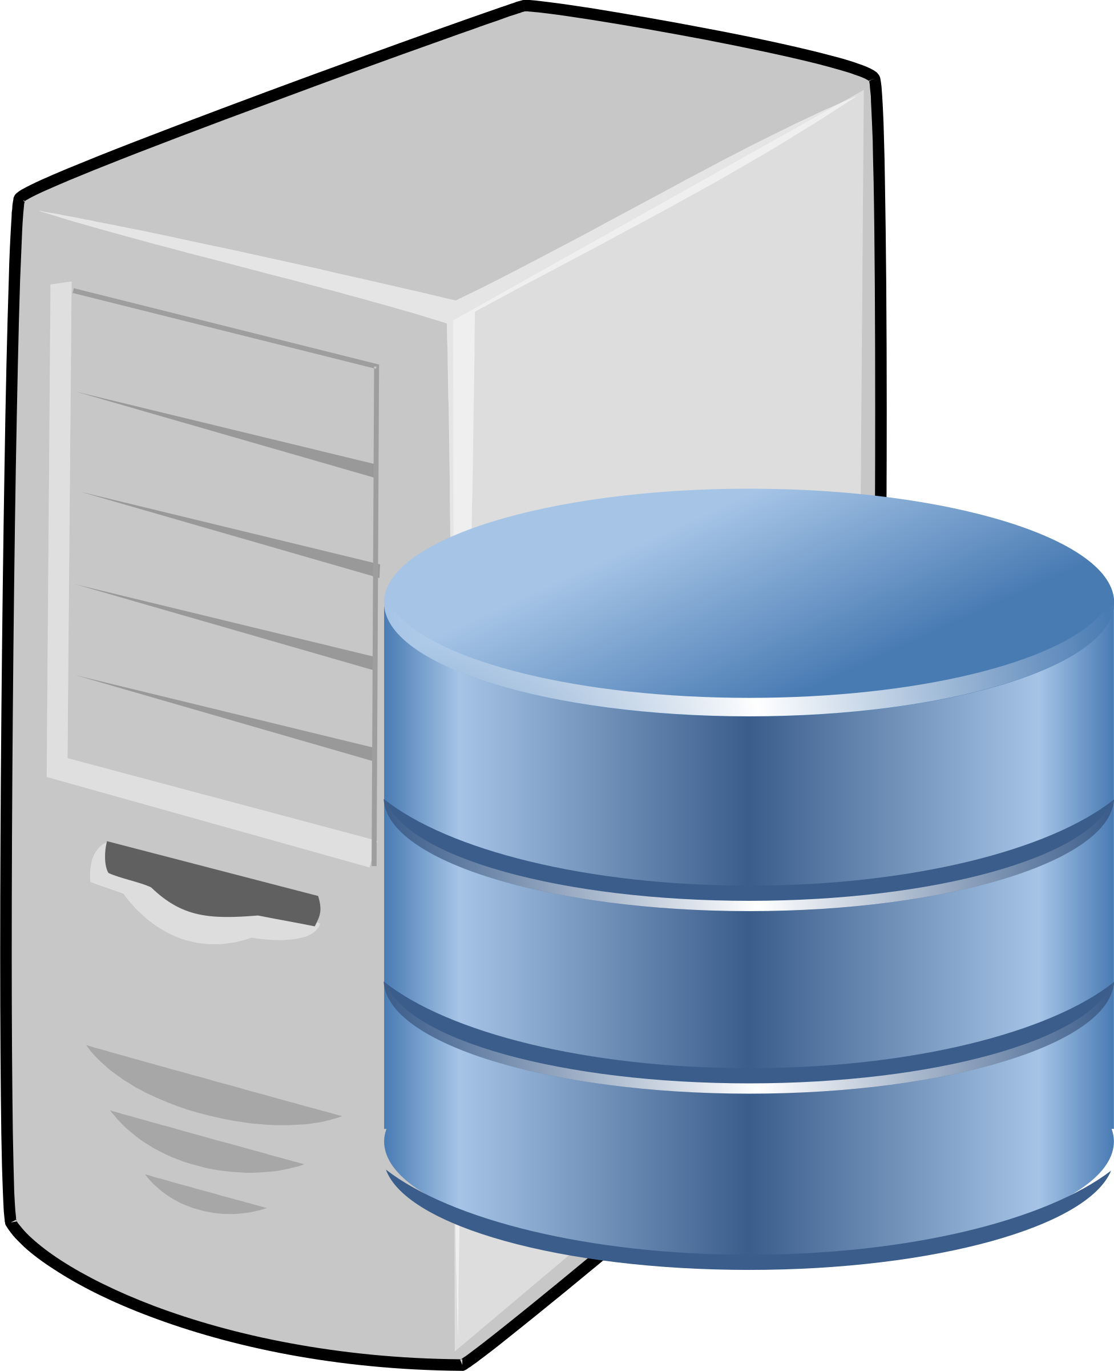
RD2. Elastico: Scaling by sharding
Nodes
epoch i
epoch i
Block I₁
Block I₂
Block I₃

Slide 17
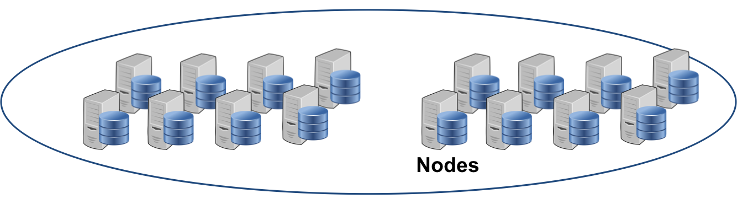
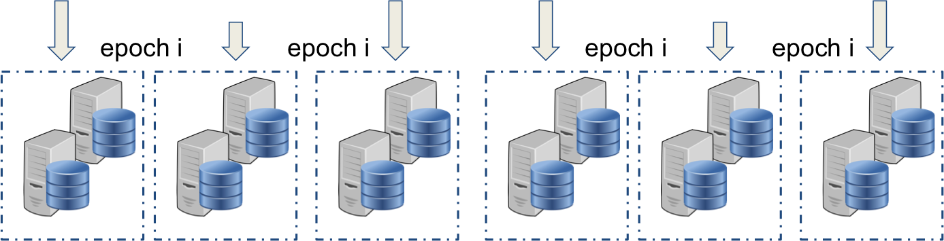
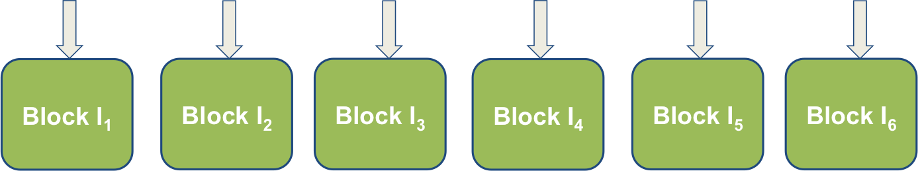
More Nodes, More transactions

Slide 18
On-going Projects

Slide 19
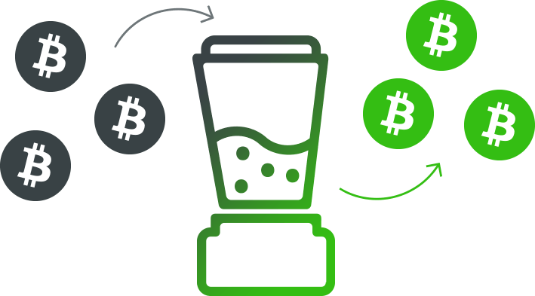
On-going projects
RD2. SgxMixer: An IntelSGX-based mixer for Bitcoin transactions
A practical, efficient mixing protocol for Bitcoin transactions
Guarantee transaction privacy
Intel SGX

Slide 20
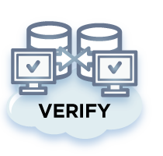
On-going Projects
RD2. DeSybil: Establish Secure P2P Connections In Open Network
Allow nodes in open network to find and connect to each other securely
RD2. TrueBit: Verification for Blockchains
Reduce verification cost for blockchains
Received $10k from WanXiang Blockchain Lab

Slide 21
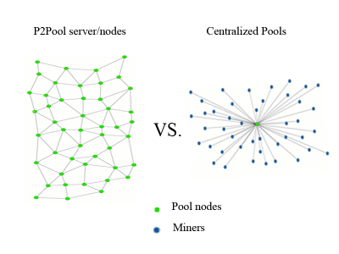
On-going Projects (3)
RD3. SmartPool: A decentalized pooled mining
Pooled mining
Reduces variance in reward
But decreases decentralization
Using smart contract to build decentralized mining pools
Low variance
Highly decentralized

Slide 22
Future work
Rely more on hardware
Use different consensus protocols
Combining techniques from different fields
Programming language, distributed system, applied crypto, etc.
More applications
Public & private settings

Slide 23
Published Papers
Making Smart Contract Smarter [CCS ’16, Loi Luu et al.]
A Secure Sharding Protocol For Open Blockchains [CCS ’16, Loi Luu et al.]
Demystifying incentives in the consensus computer [CCS ’15, Loi Luu et al.]
On Power Splitting Games in Distributed Computation: The Case of Bitcoin Pooled Mining [CSF ’15, Loi Luu et al.]
A Model Counter for Constraints Over Unbounded Strings [PLDI ’14, Loi Luu et al.]

Slide 24



Thanks
https://comp.nus.edu.sg/~loiluu
loiluu@comp.nus.edu.sg
https://github.com/loiluu

